Slide 1
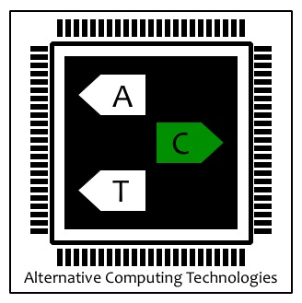
BiHiwe: Mixed-Signal Charge-Domain Acceleration
Soroush Ghodrati
PhD Student at Computer
Science and Engineering
Alternative Computing Technologies (ACT) Lab
University of California, San Diego

Slide 2
Challenges in Analog Computing
Limited range of
information encoding
Challenges
Susceptibility to noise
Analog to Digital (A/D)
Conversion overheads

Slide 3
Challenges in Analog Computing
Limited range of
information encoding
Challenges
Susceptibility to noise
Low-bitwidth MACC
operations
Low-bitwidth
MACC operations
Modeling noise
during training
Analog to Digital (A/D)
Conversion overheads
Utilizing the switched-capacitor circuits
Low-bitiwidth MACC operations

Slide 4
Our Approach: Wide, Interleaved, and Bit-Partitioned Arithmetic
Each vector has
two 4-bit values
Vector dot-products can be
bit-partitioned into groups
of low bitwidth operations

Slide 5
Our Approach: Wide, Interleaved, and Bit-Partitioned Arithmetic
Each vector has
two 4-bit values
Vector dot-products can be
bit-partitioned into groups
of low bitwidth operations

Slide 6
Our Approach: Wide, Interleaved, and Bit-Partitioned Arithmetic
Each vector has
two 4-bit values
Vector dot-products can be
bit-partitioned into groups
of low bitwidth operations

Slide 7
Our Approach: Wide, Interleaved, and Bit-Partitioned Arithmetic
Each vector has
two 4-bit values
Vector dot-products can be
bit-partitioned into groups
of low bitwidth operations

Slide 8
Wide, Interleaved, and Bit-Partitioned Vector Dot-Product

Slide 9
Wide, Interleaved, and Bit-Partitioned Vector Dot-Product
Using low-bitwidth operands provides
larger headroom between value
encoding in analog domain and
reduces the energy/area overhead
of A/D and D/A converters

Slide 10
BiHiwe Microarchitecture
Mixed-Signal Bit-Partitioned MACC Array:
A wide array of low-bitwidth MACC units share single A/D converter

Slide 11
BiHiwe Microarchitecture
Mixed-Signal Bit-Partitioned MACC Array: MACC
Operations and Private Accumulation

Slide 12
BiHiwe Microarchitecture
Mixed-Signal Bit-Partitioned MACC Array:
Accumulating across MACCs and starting A/D conversion

Slide 13
Low-Bitwidth Switched-Capacitor MACC
A charge proportional to the magnitude of X is stored on C_{x}

Slide 14
Low-Bitwidth Switched-Capacitor MACC
The sampled charge by C_{x} is shared by C_{w} .

Slide 15
Low-Bitwidth Switched-Capacitor MACC
A charge proportional to |X||W| is stored on C_{w} and a multiplication happens

Slide 16
Low-Bitwidth Switched-Capacitor MACC
The sampled charge by C_{w} is transferred to C_{ACC} and accumulated there

Slide 17
Low-Bitwidth Switched-Capacitor MACC
While the result of the multiplication is being accumulated,
a new input is sampled and a new round begins

Slide 18
BiHiwe Microarchitecture
Basic Dot-Product Engine
Our Dot-Product Engine:
MS-WAGG

Slide 19
BiHiwe Microarchitecture: Design Decisions & Tradeoffs
Improvement in Power; Step-by-Step Analysis

Slide 20
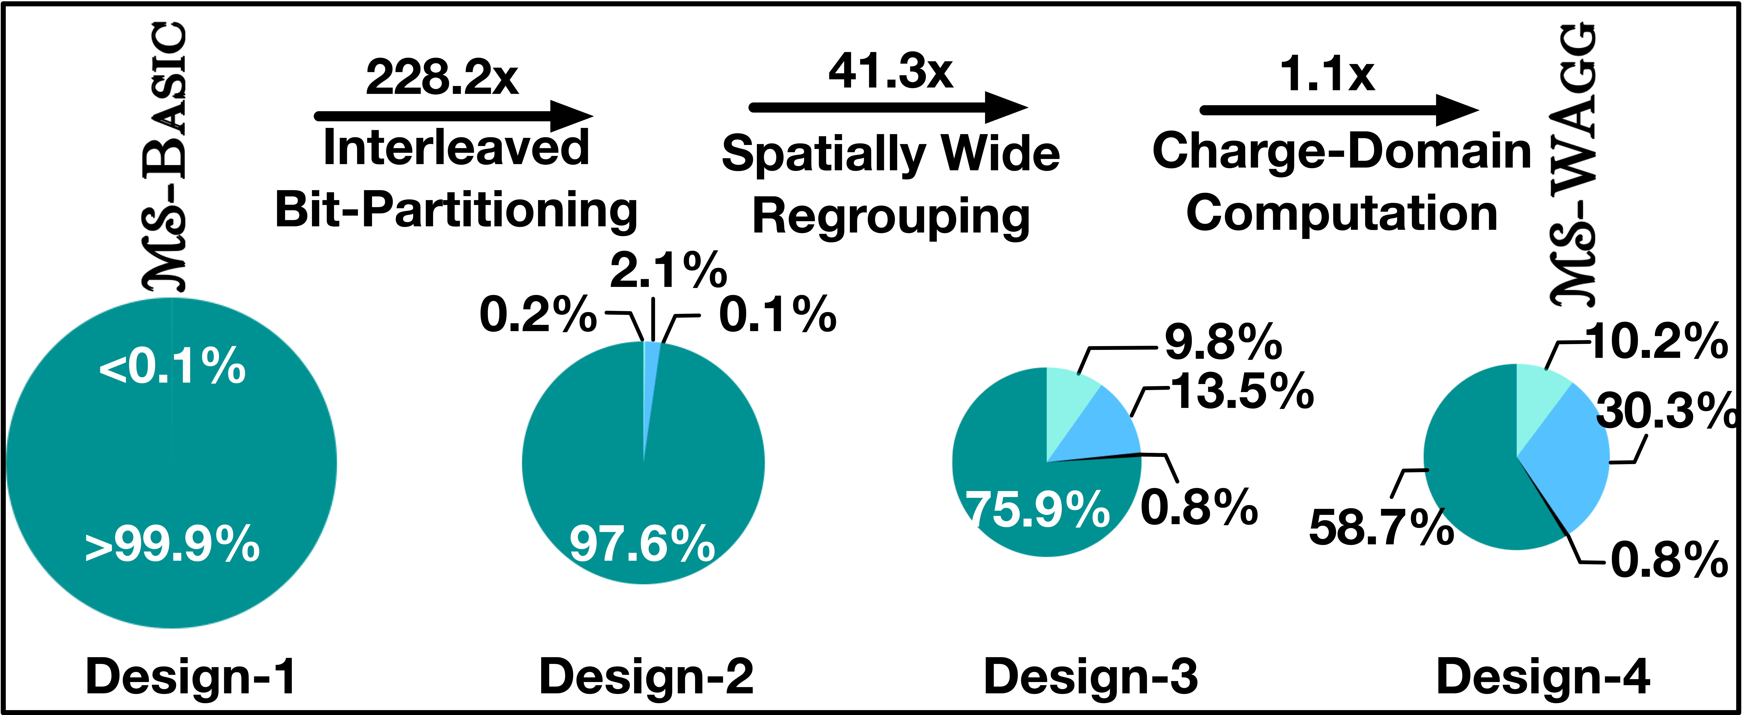
BiHiwe Microarchitecture: Design Decisions & Tradeoffs
Improvement in Area; Step-by-Step Analysis

Slide 21
BiHiwe Hierarchical Clustered Architecture

Slide 22
Mixed-Signal Non-Idealities and Their Mitigation
Thermal Noise
Charge-Domain
Computation
Non-Idealities
Incomplete
Charge Sharing
Injecting the non-idealities to the model and fine-tuning
the parameters of the model by retraining the network

Slide 23
Mixed-Signal Non-Idealities and Their Mitigation
Train a fully-precise neural network
Input the training data to the discretized neural network
Noisy Network
Calculate the output error from the circuitry non-idealities neural network
Back propagate the error through the fully-precise neural network
Ideal Network

Slide 24
BiHiwe Compilation Stack

Slide 25
Methodology
Analog Components
Switched-capacitor MACC units simulated using Cadence transistor-level simulations
ADC energy/area numbers adopted from literature survey
Technology node: 45nm
Digital Components
Digital blocks implemented using Verilog RTL
SRAM buffers modeled using CACTI-P
3D-stacked DRAM modeled using HMC stack technology
Technology node: 45 nm
Noise and Error Modeling
Noise and error models extracted from transistor-level simulations
Modeled and injected during training of neural networks using Distiller framework in PyTorch

Slide 26
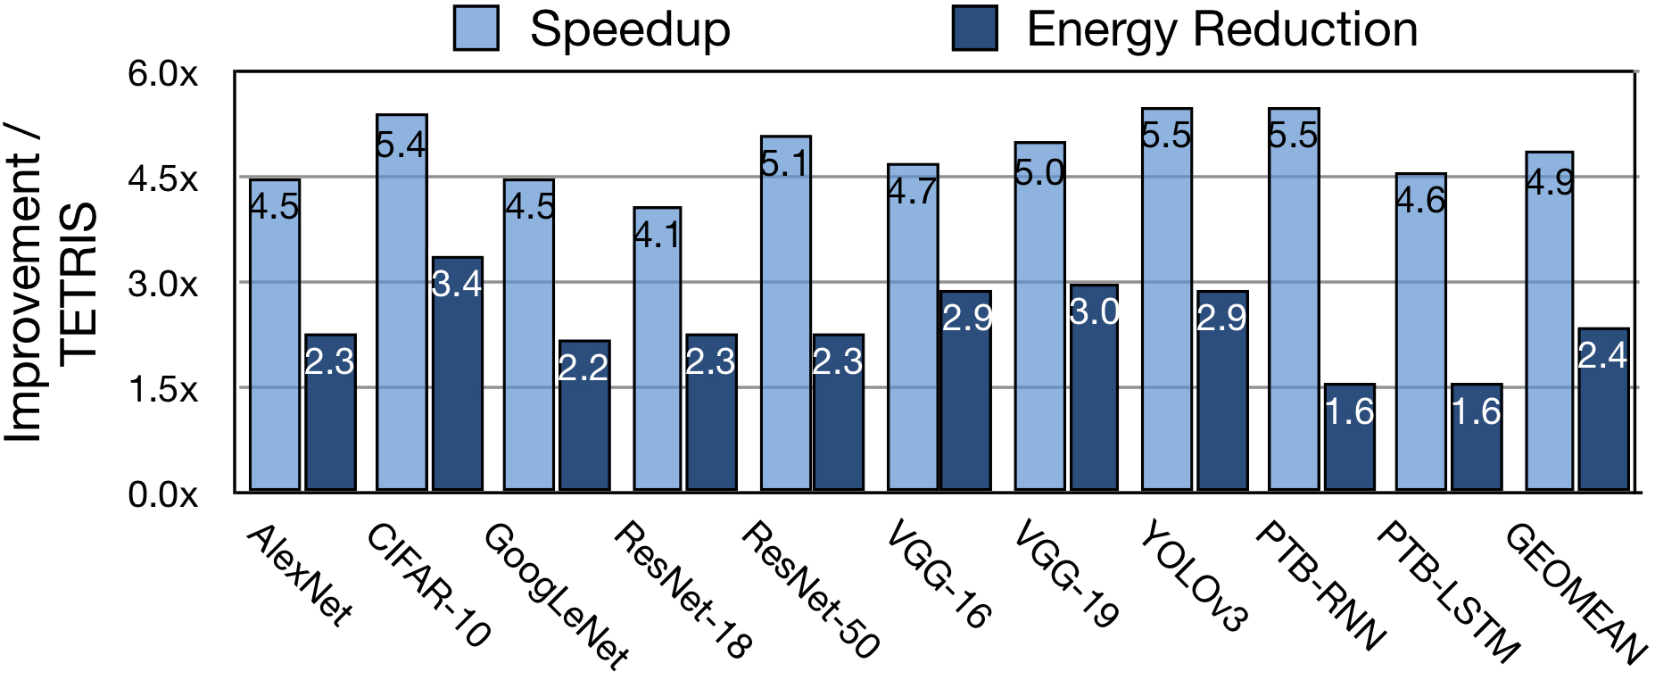
Comparison with Tetris
4.9x speedup and 2.4x energy reduction over Tetris,
an optimized 3D-stacked fully-digital accelerator for DNNs

Slide 27
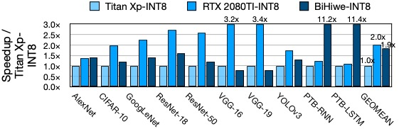
Comparison with GPUs
BiHiwe delivers 70.1x and 35.4x higher Performance-per-Watt
compared to Nvidia Titan Xp and RTX 2080 TI

Slide 28
Comparison with Other Accelerators
BiHiwe outperforms other analog and digital accelerators in power-efficiency

Slide 29
Design Space Exploration for Bit-Partitioning
2-bit bit-partitioning is the optimal choice based
on this design style and technology node

Slide 30
Design Space Exploration for # of cores
Each cluster (vault) of the BiHiwe consists of four accelerator cores

Slide 31
Design Space Exploration for MS-BPMAcc
Each MS-BPMAcc in BiHiwe has an array of 8 low-bitwidth MACC units
which perform operations for 32 cycles before A/D conversion

Slide 32
Evaluating Circuitry Non-Idealities
BiHiwe has no virtual impact on the classification accuracy of the DNN models

